Slide 1
Understanding Knowledge and Bias
WRT 101S

Slide 2
“Know Thyself” - Ancient Greek Saying
In Class Writing:
Identify yourself in the rhetorical situation:
Who are you as a person?
Who are you as a writer?
Who are you as a student?
What roles do you play in society?

Slide 3
Rhetorical Situation/Triangle
Develop rhetorical awareness
Writer/Speaker
Message
Audience

Slide 4
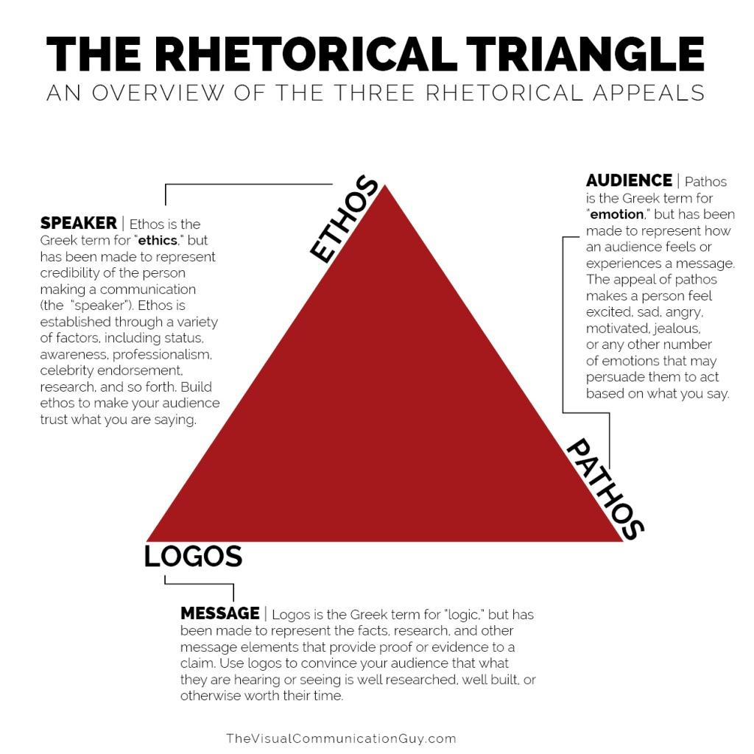

Slide 5
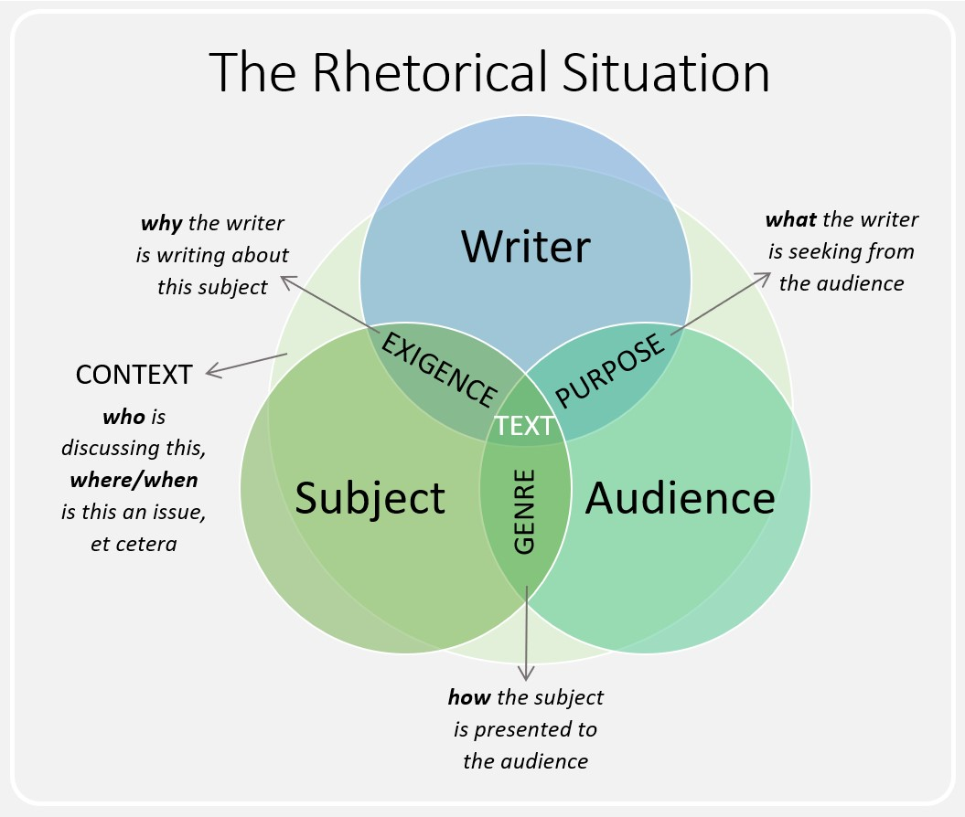

Slide 6
Rhetorical Analysis
analysis: breaking something down and studying its parts to gain a better understanding of it and its effect(s)
rhetorical analysis: studying an argument for its rhetorical elements to gain a better understanding of its persuasive/rhetorical effect(s)/effectiveness
The process of rhetorical analysis requires a critical audience/reader/thinker/observer to conduct the analysis thoughtfully and fairly.

Slide 7
What is a rhetorical argument?
A reason or set of reasons given with the aim of persuading others that an action or idea is right or wrong.

Slide 8
Rhetorical Analysis Questions
Who wrote it? What is their ethos?
Who is it meant
for? Who interacts
with it? Who is
influenced by it?
Is it effective?
Does it have the
influence the author/publisher
intended for it to have?
What does it argue? What is the purpose of the message? How is it put together? What are their reasons?

Slide 9
knowledge: facts, information, and skills acquired by a person through education and experience
bias: (noun) prejudice in favor of or against one thing, person, or group compared with another
bias: (verb) cause to feel or show inclination or prejudice for or against someone or something
truth: that which is in accordance with fact or reality
reality: a thing that is actually experienced or seen
opinion: a view or judgment formed about something not necessarily based on fact or knowledge

Slide 10
How do we know what we think we know is true?
We can’t.

Slide 11
From Where Do We Get Our Knowledge?
extensional world
what we have seen, felt, or heard
the flow of events passing before our senses in real-time
first-hand information/knowledge
verbal/visual worlds
how we acquire most of our knowledge
what we are told about but haven’t experienced for ourselves

Slide 12
From where/whom do we receive second-hand (verbal/visual) information?
parents
friends
school
newspapers
books
conversations
speeches
photos
videos
the internet
social networks
TV

Slide 13
How do we get closer to understanding truth/judging information and arguments for accuracy?

Slide 14
Know Your and Others’ Biases
Our prior beliefs and opinions affect how we interpret new information. For example, when we believe something is true before researching it, we are more likely to believe something that supports those prior beliefs or opinions.
confirmation bias: the tendency to search for, interpret, favor, and recall information in a way that confirms one’s preexisting beliefs or hypotheses.

Slide 15
The Importance of Recognizing Biases in Rhetorical Analysis
We all have biases towards certain ways of thinking.
To analyze something as a critical audience, we need to first acknowledge and understand our biases and counteract/work against them.
This is so that when we rhetorically analyze an argument, we can effectively analyze the evidence presented from a neutral/objective lens.

Slide 16
Identify and Prevent the Spread of Misinformation
Misinformation: false or inaccurate information
Types: False rumors, insults, pranks, hoaxes, spam, scams, propaganda, parody or satirical news if taken as fact, fake news sites, conspiracy theories, fake information in graphics, images, or videos, misapplied content, manipulated content

Slide 17
Read Critically
It’s a balance: don’t be too gullible (believing everything your read, are told, or come across) and don’t be too paranoid that all information is incorrect.
Remember: it is highly probably (or even inevitable) that even as critical and balanced readers, we will believe an error to be true and/or disregard factual information as incorrect.

