Slide 1
Formal Logic
Inductive Reasoning:
  Generalizing a conclusion based on a number of specific examples.
    Bottom-up logic: “All the articles we have read in WRD104 are boring, therefore all reading is boring”
Deductive Reasoning:
  Reaching a conclusion by assuming a general principle and applying it to a specific example
        Major Premise: “All men are mortal”
        Minor Premise: “All Greeks are men”
        Conclusion: “All Greeks are mortal”

Slide 2
Classical Oration
Used in Ancient Greece to present cases in courts or to make speeches to a senate.

Slide 3
Classical Oration
Seen today in:
Political debates & speeches
Basic persuasive 5-paragraph essays:
      Introduction
      Background
      Lines of Argument
      Alternative Arguments
      Conclusion

Slide 4
Classical Oration
Traditional Classical Oration is comprised of 6 parts:
  Exordium: Writer attempts to win attention & goodwill of an audience while introducing a subject/problem (Introduction)
  Narratio: Writer presents the facts of the case – places argument in context
  Partitio (contained within the Narratio): Writer divides the subject, explaining
      What the claim is
      What the key issues are
      What order the subject will be treated

Slide 5
Classical Oration
6 Parts of Classical Oration continued:
  Confirmatio: Writer offers detailed support for the claim, using both logical reasoning and factual evidence
  Refutatio: Writer acknowledges and then refutes opposing claims or evidence (Counterargument & refutation)
  Peroratio: Writer summarizes the case and moves the audience to action (Conclusion)

Slide 6
The Rogerian Method
Developed by rhetoricians Richard E. Young, Alton L Becker and Kenneth L Pike
Based on American psychologist Carl Rogers’ methods of conflict resolution – seeks compromise (as opposed to the Classical Oration’s goal of establishing winners and losers)

Slide 7
The Rogerian Method
3 main goals:
Connect with audience to communicate their position is heard and understood
Identify the shared elements of the audience’s position (the elements the author deems valid)
Establish a compromise that honors and values both groups’ morals

Slide 8
The Rogerian Method
Introduction: Writer describes an issue/problem/conflict demonstrating both understanding and respect for all positions
Contexts: Writer describes the contexts in which alternative positions may be valid or legitimate
Writer’s Position: Writer presents his/her position on the issue and presents the circumstances in which that opinion would be valid
Benefits to Opponent: Writer explains to opponents how they would benefit from adopting his/her position.

Slide 9
The Toulmin Method
Stephen Toulmin, 1958
Favored because it acknowledges the complications of life.
  Uses qualifying language:
    Sometimes
    Often
    Unless
    Almost

Slide 10
The Toulmin Method
The Claim:
  Identify the Claim: is it controversial and debatable?
  Look for Qualifiers: avoid absolute claims
  Find the Exceptions: acknowledge the counter-argument
  Summarize the Claim! Qualifier, claim, exception.

Slide 11
The Toulmin Method
Analyzing the Reasons:
  List the Reasons
    How can they be organized?
    Qualified?
  Examine the Reasons
    Are they good reasons?
    What are the values implied by your reasons?
    Are the reasons relevant to the thesis?

Slide 12
The Toulmin Method
Warrants:
  The logical and persuasive connection between a claim and the reasons and data supporting it.
  Usually a general principle or value you share with your reader (the major premise of Syllogisms)

Slide 13
The Toulmin Method
Analyzing the Evidence:
  List the Evidence:
    Anecdotes?
    Data?
    Case studies?
  Examine the Evidence:
    Is it sufficient, credible and accurate?
    Is it relevant to the claim it supports?

Slide 14
The Toulmin Method
Noting Refutations:
  What are the alternative stances?
    Are you fairly addressing this stance? No Straw Men.
  What is a strong rebuttal to that stance?

Slide 15
The Toulmin Method
Summarizing Your Analysis
  What is the result of your argument?
  Summarizing in a paragraph or two will reinforce your stance and clearly draw together all elements of the argument

Slide 16
Fallacies:
- Appeals to the Mind
- Appeals to Emotion
- Manipulating Content
- Faulty Deductions
- On the Attack
- Cause & Effect

Slide 17
Appeals to the Mind:
Appeals to Authority
Definition
Example
Claiming something is true because an “expert” says it is
Using evidence from an unnamed “expert” or group to claim something is true
“They say once you get a cat, you’ll love them for life!”
“Hundreds of prestigious doctors agree ADHD is a made-up disorder.”

Slide 18
Appeals to the Mind:
Appeal to Common Practice
Definition:
Example:
Claiming something is true because it is commonly practiced.
“Social media must be good, because everyone uses it.”

Slide 19
Appeals to the Mind:
Appeal to Tradition
Definition:
Example:
Claiming something is true because it has “always” been that way.
“Women have traditionally played the homemaker, therefore that is their rightful place in a family”

Slide 20
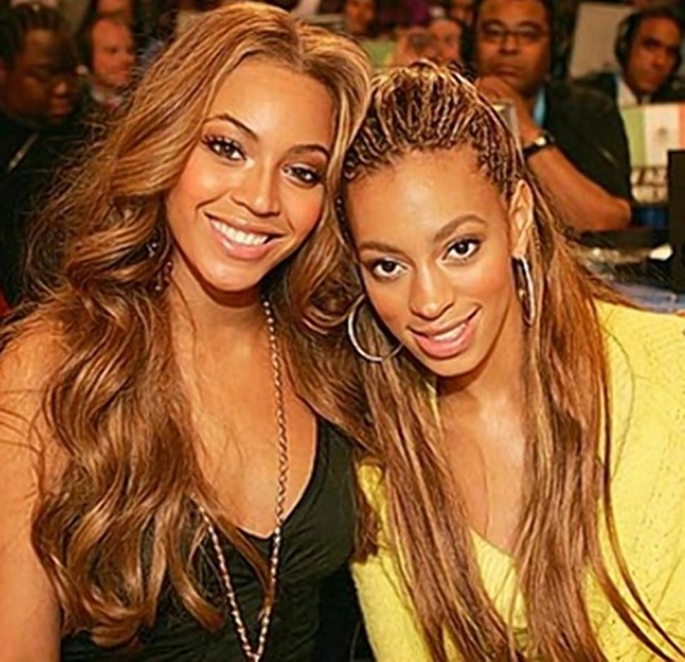
Appeals to the Mind:
Appeal to Popular Belief
Definition:
Example:
Claiming something is true because the majority of people believe it.
Beyoncé & Solange must be in a feud because everyone is saying they are!

Slide 21
Appeals to Emotions:
Pity – attempting to induce pity to sway opponents
Spite – Dismissing a claim by appealing to personal bias against the opposition
Fear – An argument made by increasing fear and prejudice towards the opposition
Nature – Making your claim seem more true by drawing comparisons to what is “natural”

Slide 22
Manipulating Content:
Begging the Question
Definition:
Example:
Making a claim while leaving out one or more major contributing factors that may affect the conclusion
“Labeling food with food warnings will encourage people to eat healthier”
(People need to be able to understand labels; People need healthy food options)

Slide 23
Manipulating Content:
Red Herring
Definition:
Example:
Introducing irrelevant material to the argument to distract and lead towards a different conclusion.
“The senator doesn’t need to account for irregularities in his expense account. After all, there are other senators who have done worse things”

Slide 24
Manipulating Content:
Slippery Slope
Definition:
Example:
Assuming a relatively small first step will inevitably lead to a chain of related, negative events.
“If we allow same sex marriage, people will eventually want to marry animals or inanimate objects.”

Slide 25
Faulty Deductions:
Anecdotal Evidence
Definition:
Example:
Discounting Evidence arrived at by systematic search or testing in favor of a few first hand stories.
It’s okay to smoke – my grandfather did for 70 years, and lived to be 85!

Slide 26
Faulty Deductions:
Hasty Generalization
Definition:
Example:
Drawing a conclusion from a tiny sample.
“The guy’s cologne on the train smelled awful. All cologne is awful!”

Slide 27
Faulty Deductions:
Sweeping Generalization
Definition:
Example:
Applying a general rule too broadly.
“First Year Writing is a class for freshmen. Everyone enrolled in WRD104 must be an 18 or 19 year old freshman”

Slide 28
On The Attack:
Ad Hominem
Definition:
Example:
Bypassing the argument by launching an irrelevant attack on the person, not the claim.
Of course she shouldn’t be reelected to office, she looked horrible at that last inaugural event!”

Slide 29
On The Attack:
Straw Man
Definition:
Example:
Creating a distorted or simplified version of the opposition’s stance, and arguing against that.
“You say Israel should stop building settlements on the West Bank? So you’re saying Israel doesn’t have the right to be a nation?”

Slide 30
Cause & Effect:
Post Hoc Ergo Propter Hoc
Definition:
Example:
Claiming that because one event followed another, it is also caused by it.
“Since Obama was elected, more people than ever are unemployed. Obama is bad for the economy”

Slide 31
Cause & Effect:
Causal Fallacy
Definition:
Example:
Claiming two events that occur together must have a cause-and-effect relationship.
“Rap music is violent, and teens listen to rap music. Therefore, rap music must cause teens to be violent.”

Slide 32
Cause & Effect:
Affirming the Consequent
Definition:
Example:
Assuming there’s only one explanation for the observations you’re making.
“A lot of people who use social media also have short attention spans. Social media must effect attention span.”

